Slide 1
Problem formulation
How often have you noticed problems with the network at the university?
Are there problems with the network in basements or in separate blocks?
Problems encountered in the portal during the registration process?
The university wants to strengthen its campus-wide network service. But how can this be done?
This work was done based on these problems.

Slide 2

IBot
Network Communication Service
Adilkhan Altynbek

Slide 3
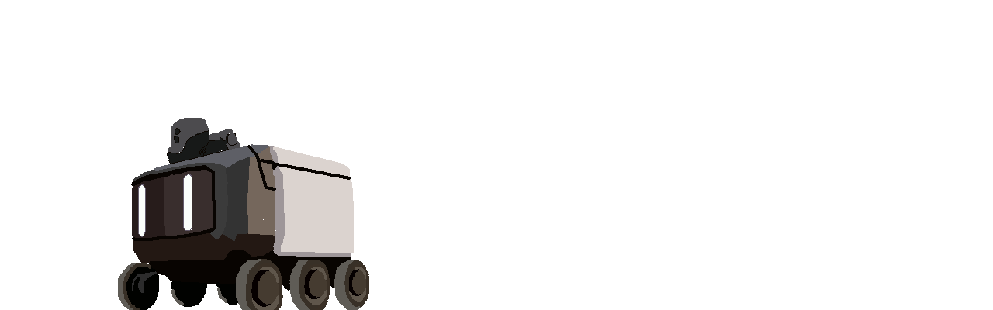
Description of ideas:
We all know what kind of robot this is, a classic cute delivery guy. This robot has very autonomous capabilities in tasks such as delivery...
But what if you give this job a device that amplifies the network signal?
This model contains motion sensors, direction and location.

Slide 4
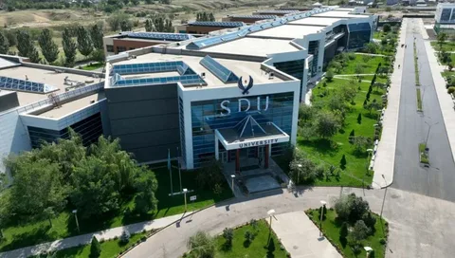
Goal:
If we take the size and location of the SDU, we can immediately assume possible problems with the Internet in its various sections, starting with remote blocks and ending with a huge flow of students in certain departments.
And for such an area, the best outcome is to provide a network and improve the quality of communication for SDU students, ensuring stable and fast Internet on campus with the help of autonomous robots with the ability to move from one point to another. And how is that? And how did we come to this? And how did we find out about this problem?

Slide 5
Interview :
I think it's worth starting with the source of the problems... I conducted several 30-minute interviews with random people at the university to identify exactly where the courier robot could be integrated, but during this task, very urgent problems were identified. And this courier was chosen by us to solve this problem...

Slide 6
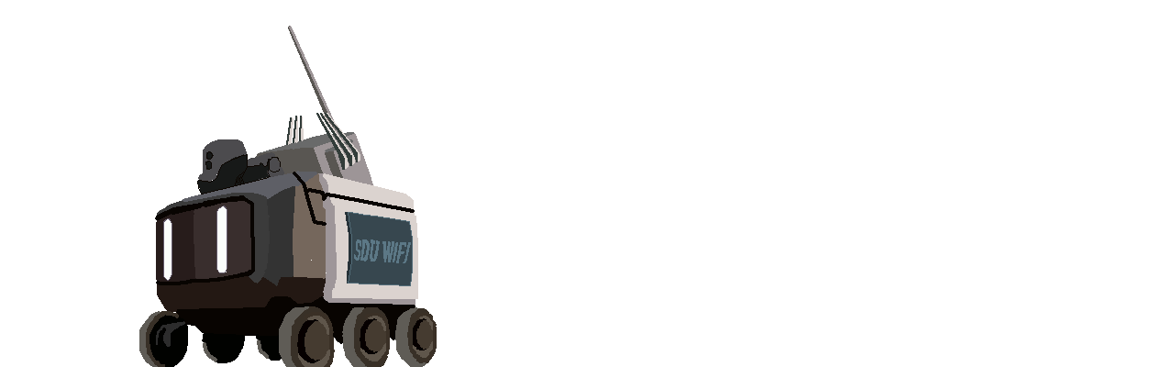
Network scanning
Signal quality sensors
Navigation system
Load analysis

Slide 7
Description of the project:
The iBot Network Communication Service is an innovative solution to improve the quality of the internet connection on the SDU campus. The iBot system automatically scans various areas of the university, analyzing the quality of the network in real time. The robot helps to fix problems with the Internet connection, providing stable access to the network wherever students are.
Key Features:
Autonomy :
Detection of weak signals:
Smart navigation:
Load optimization:

Slide 8
Description of ideas:
Goal:
Description of the project:
Key Features:
Usage Scenarios:
IBot Work structure :
Description of the project:
Technical features and architecture:
Description of ideas:
Goal:
Advantages:
Conclusion:
Usage Scenarios:
IBot Work structure :
Description of the project:
Technical features and architecture:

Slide 9
Competitive Analysis
Within the Purdue University, besides the “orientation week” type of events, many established mentorship or mentorship-like programs exist:
Supplemental Instruction (SI) sessions, where upperclassmen help new students with coursework for common freshman courses
BoilerMENTOR program which provides peer-to-peer mentorship for freshman that are recipients of Emerging Leader Scholarship
Mentorship programs within the individual university departments (e.g., Mechanical Engineering, Animal Sciences, Life Sciences, School of Management, and so on)
Mentorship programs within other specialized university departments (e.g., Honors College, Disability Resource Center, Non-traditional students, and so on)
While all these resources are clearly valuable to students, no personal, private, general, and on-demand mentorship service exists on Purdue’s campus.
Research
Brainstorming
Competitive Analysis

Slide 10
User Research
10
interviews
10-15 min
=
+
4
“mentees”
2 years or less in their current degree
6
“mentors”
3 years or more in their current degree
Research
Brainstorming
Competitive Analysis
User Research
Interviews

Slide 11
User Research
For “mentees”, I mainly asked about what kind of difficulties did they face as a relatively new student on campus, how did they solve them, what kind of resources do they use, and so on.
For “mentors”, I mainly asked about their perception of the idea of mentorship, whether they have any mentorship experience, how did those sort of relationships work out for them in the past, and so on.
Research
Brainstorming
Competitive Analysis
User Research
Interviews

Slide 12
User Research
Main themes that emerged from the “mentee” interviews were:
New students often face issues with time management and also having to live alone and take care of themselves
School resources are not easy to find and often require in-person meeting, which some feel anxious about or feel that they don’t have time for that
New students use university-provided resources (e.g., professors, teaching assistants, advisors, etc) for academic support and use friends/peers for emotional/social/psychological type of support
Research
Brainstorming
Competitive Analysis
User Research
Interviews

Slide 13
User Research
Main themes that emerged from the “mentor” interviews were:
No formal mentorship experience, however plenty of mentorship-like experience (e.g., giving advice or helping out less experienced students)
Interaction often happens naturally rather than formally (e.g., in a student club setting, doing some sort of activity based on common interests like playing video games together)
Less experienced students approach about not only academic-related questions (e.g., coursework), but also about other more personal matters (e.g, where to buy winter clothing, how to behave during career fairs, etc)
Concerns about time committment of being a “formal” mentor
Don’t mind being approached and providing help/advice, however do not actively seek students in need or enroll in official mentorship programs
Research
Brainstorming
Competitive Analysis
User Research
Interviews

Slide 14
User Research
Research
Brainstorming
Competitive Analysis
User Research
With the insights gathered from the interviews, I created two personas: Sachin (mentee) and Chloe (mentor)
Interviews
Personas

Slide 15
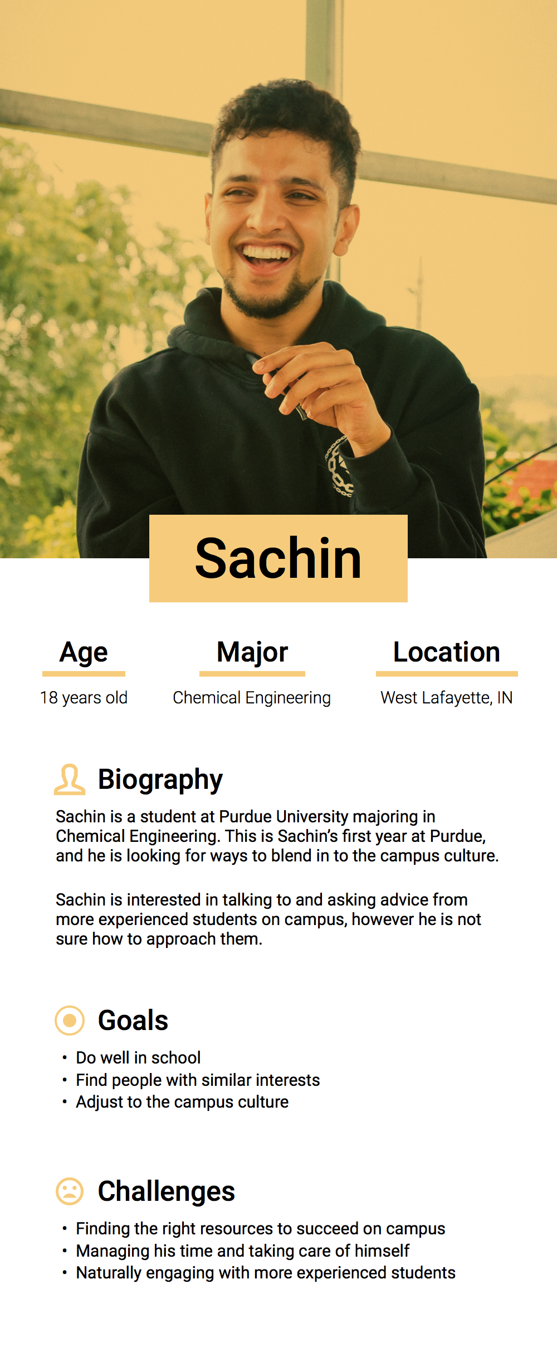
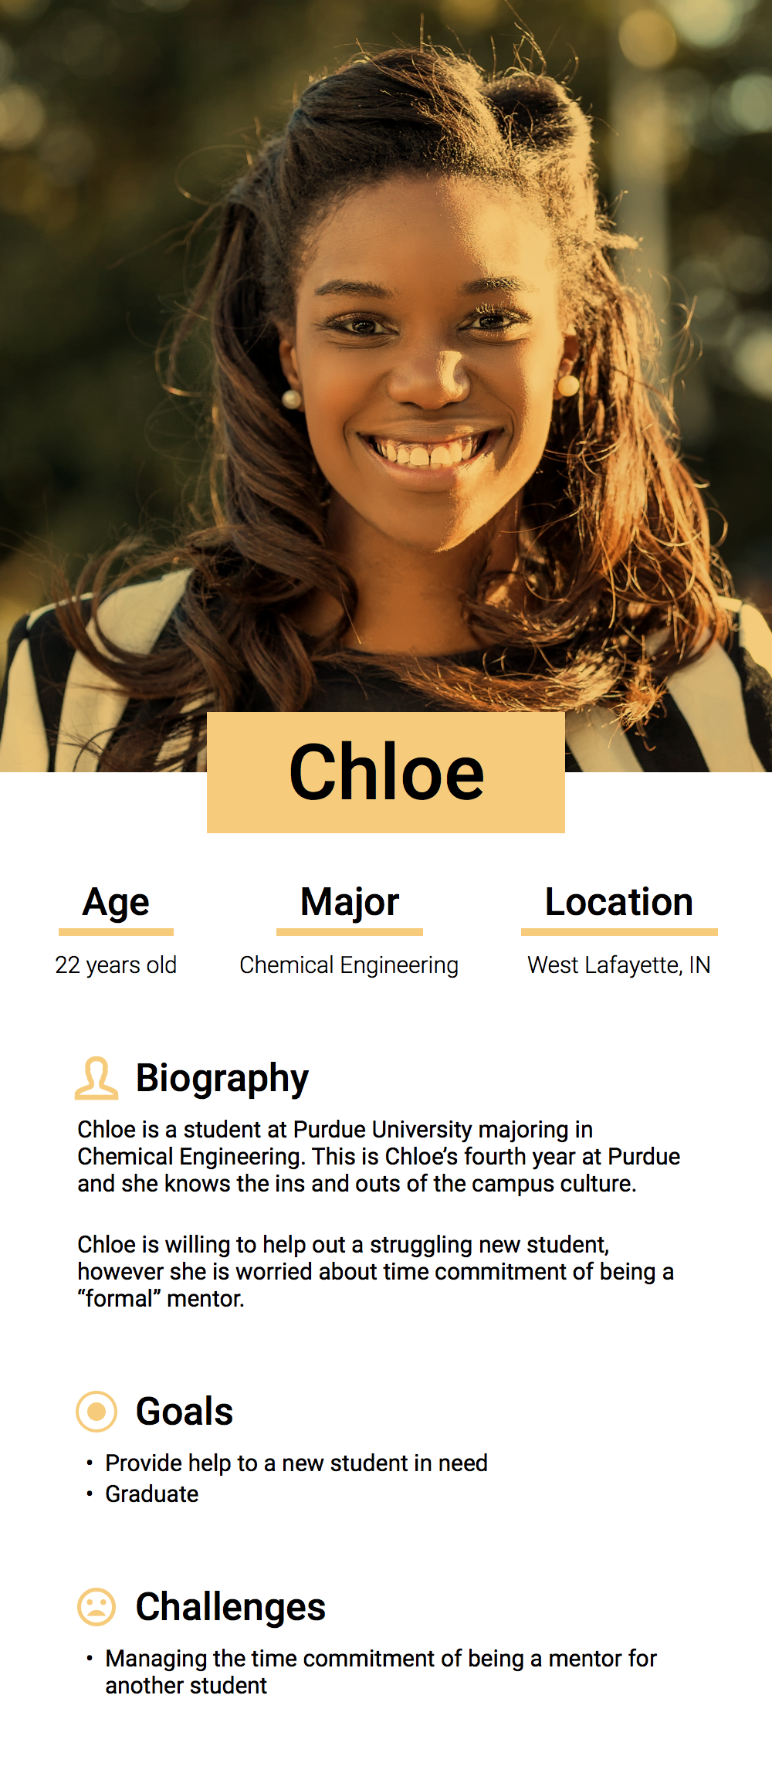
Personas
Research
Brainstorming
Competitive Analysis
User Research
Interviews
Personas

Slide 16
User Research
Research
Brainstorming
Competitive Analysis
User Research
Then to have an idea of potenial design requirements and the context in which the users can use the technology, I created a quick set of scenarios.
Interviews
Personas
Scenarios

Slide 17
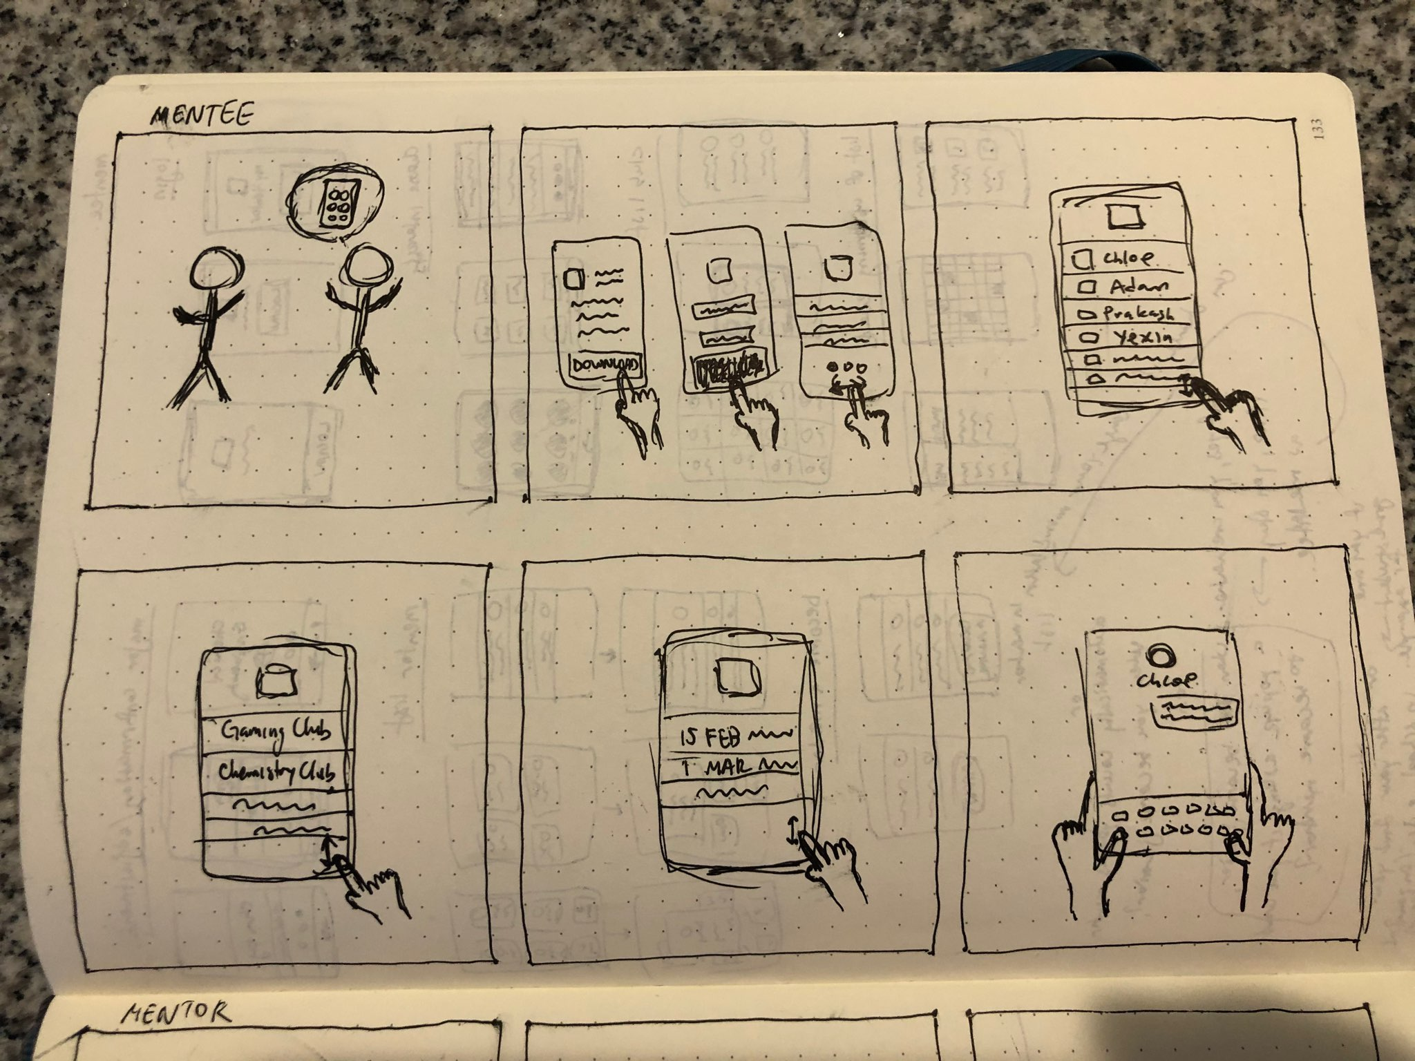
Sachin’s friend tells him about the app
He logins and fills his info
He checks out the mentors page
He checks out the clubs page
He checks out the upcoming events page
He messages one of the mentors
Research
Brainstorming
Competitive Analysis
User Research
Interviews
Personas
Scenarios

Slide 18
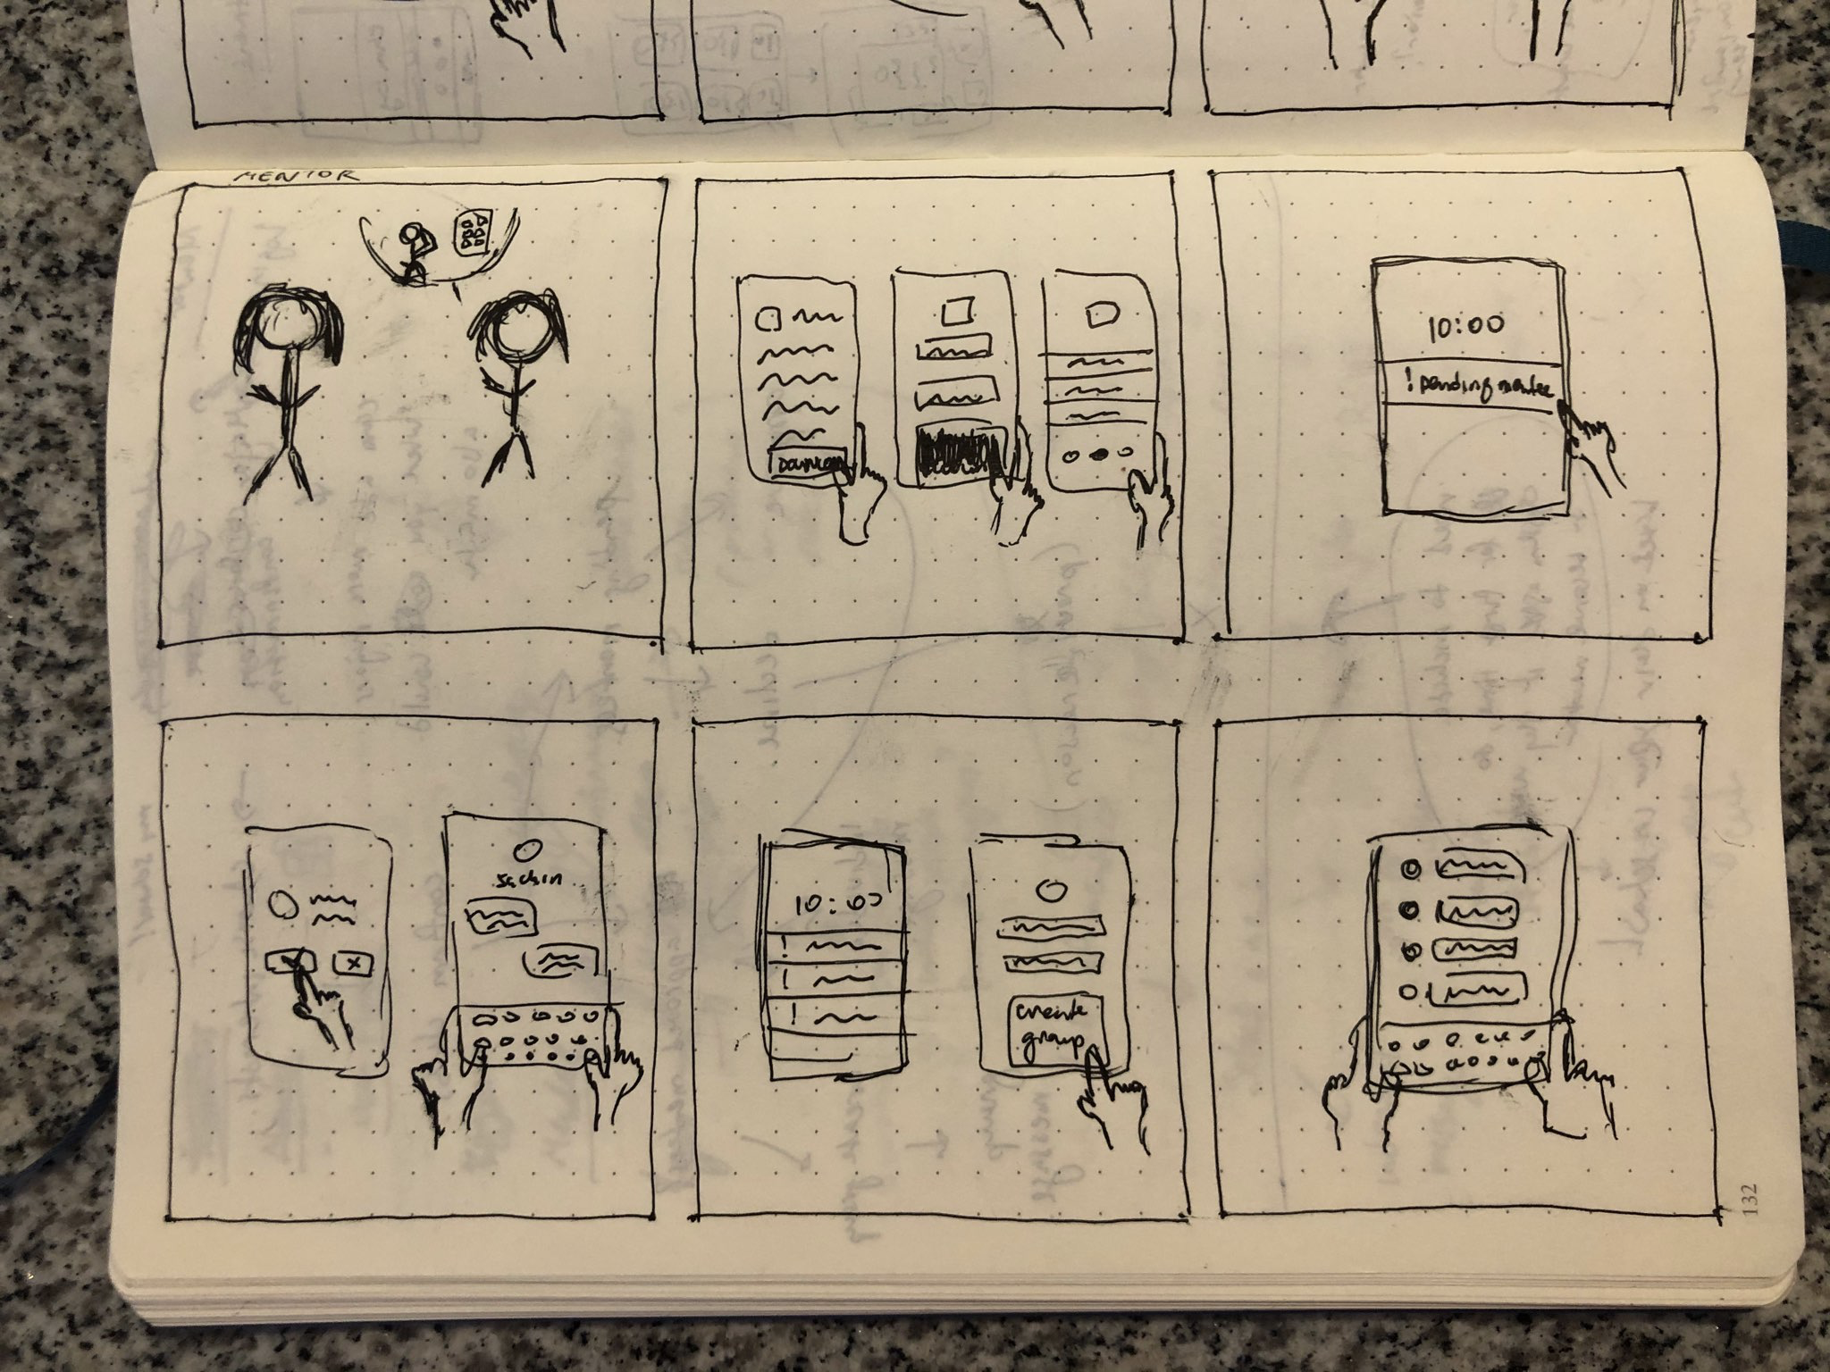
Chloe’s professor tells her about the app
She logins and fills her info
She receives a notification about a pending mentee application
She approves and messages her mentee
Chloe creates a group of her mentees
She messages her group
Research
Brainstorming
Competitive Analysis
User Research
Interviews
Personas
Scenarios

Slide 19
Insight
From the insights gathered from research, I modified the problem framing. Experienced students are eager to help and are not against the idea of mentorship. However, they worry about time committment and are not motivated to go out of their way to contact the struggling new students.
New students can feel anxious about having to meet in-person with their potential mentors and also worry about time committments of such meetings.
Based on these insights, I crafted a mission statement and a list of goals for how that will be achieved.
Research
Brainstorming
Competitive Analysis
User Research
Insight

Slide 20
Mission Statement
A digital experience that provides a welcoming, supportive, and nurturing environment for new students on university campuses

Slide 21
Goals
Help new students reach out to more experienced students based on their needs and goals
Help proactive experienced students find and help struggling new students
Allow students find more experienced students naturally, through student clubs and other initiatives

Slide 22
Design
Design
With a clear idea of the problem in mind, I moved to designing the UI so I could turn my research findings into visual elements.

Slide 23
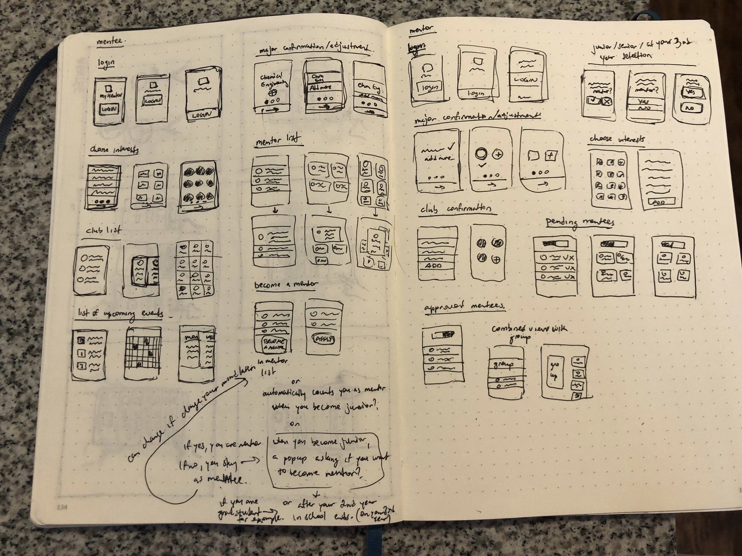
Sketches
I started with some rough sketches to map the functionality of the application and the rough placement of the elements.
Design
Sketches

Slide 24
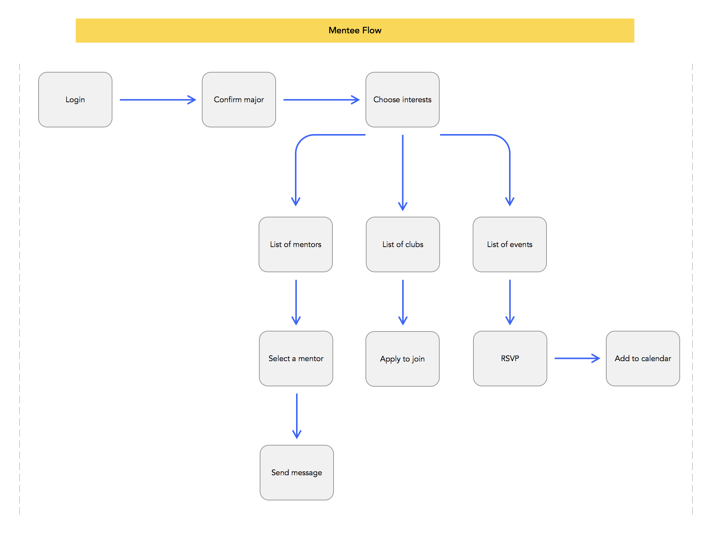
User Flow
Then, to map out how the users will interact with the app, I did some quick user flows for mentees and mentors.
Design
Sketches
User Flow

Slide 25
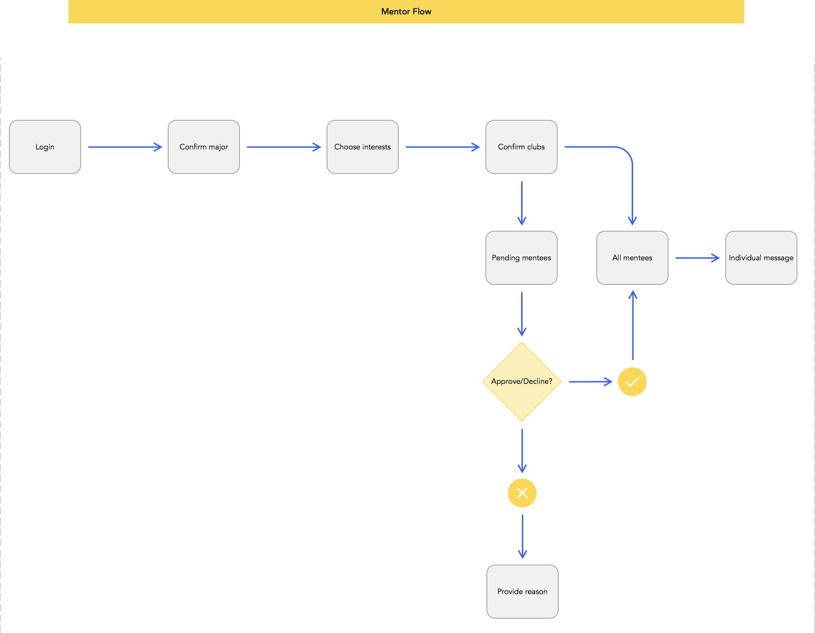
User Flow
Design
Sketches
User Flow

Slide 26
Wireframes
Design
Sketches
User Flow
Wireframes
With an idea of the functionality, elements placement, and the overall flow of the app, I went ahead and did wireframes in Sketch

Slide 27
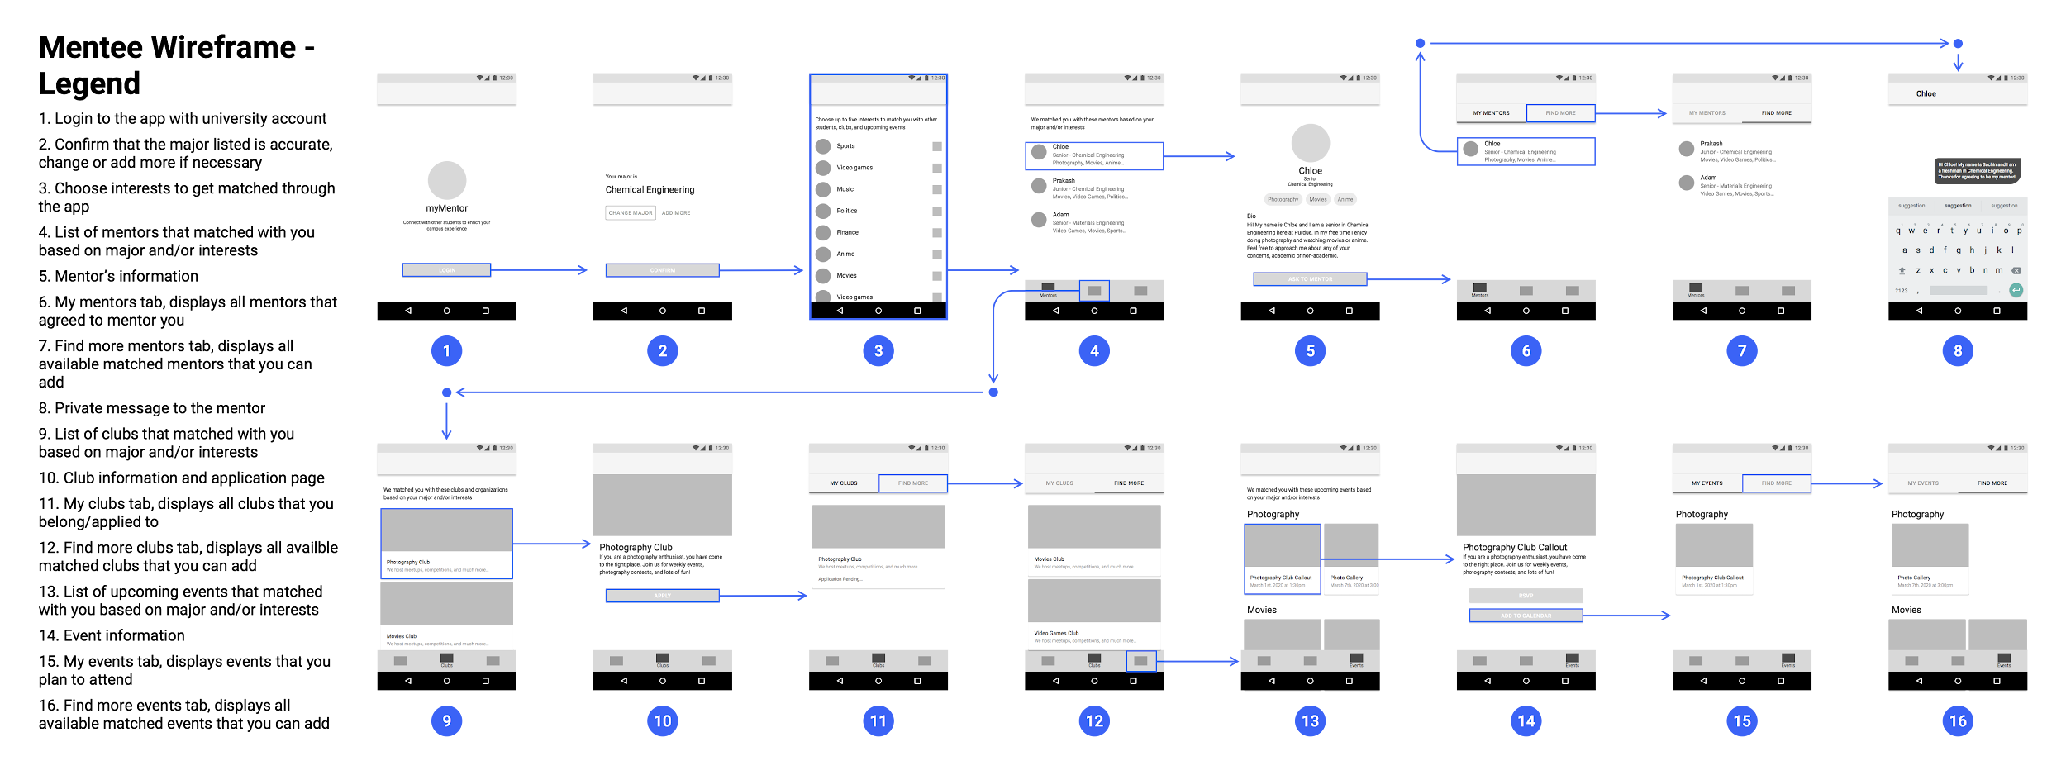

Slide 28
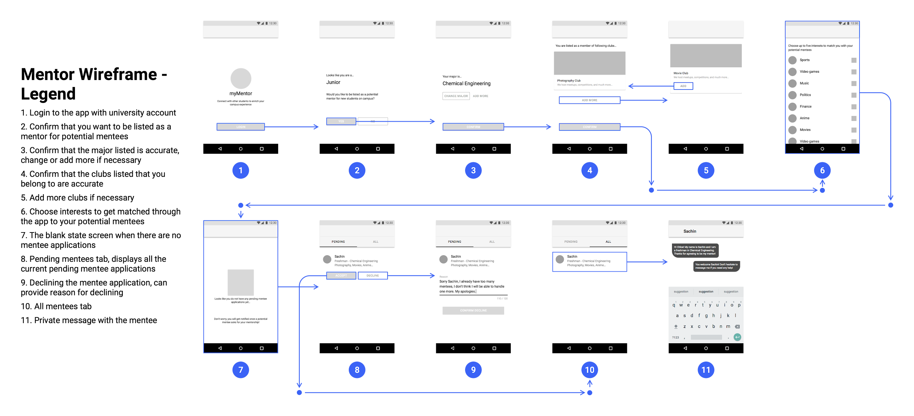

Slide 29
Final Design
Design
Sketches
User Flow
Wireframes
Final Design

Slide 30
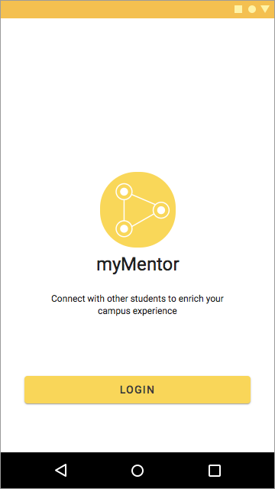
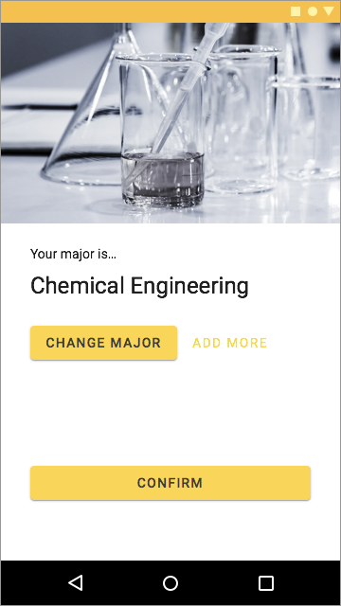
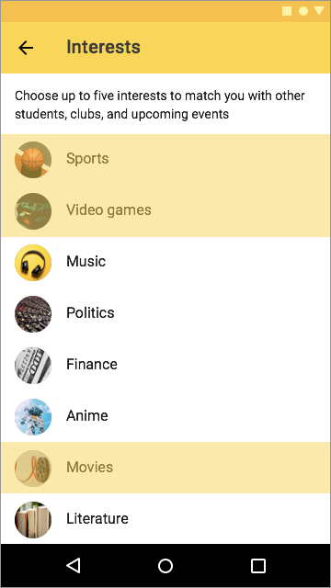
“Mentees” login with their university account. myMentor automatically detects their major and asks them to confirm it.
If the major is displayed incorrectly, students can change it manually. They can also add their minor or related majors.
As the last step of the application setup, students can choose their interests to help myMentor match them with right resources. By matching the mentees and mentors based on their interests and/or major, myMentor helps them connect more naturally.

Slide 31
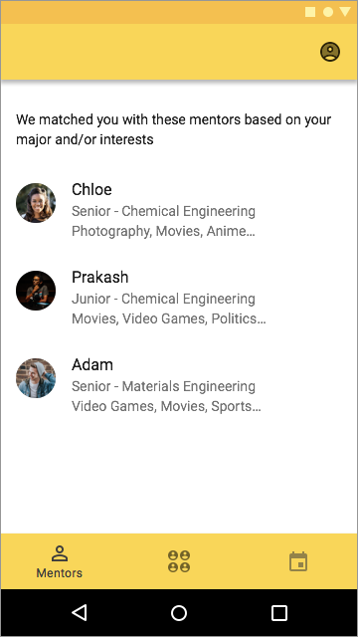
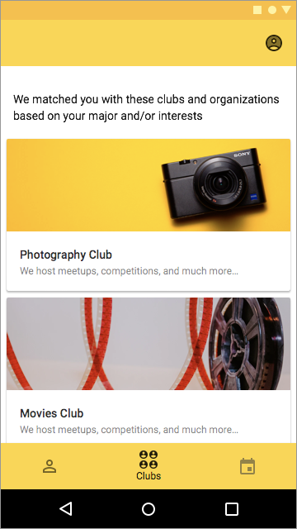
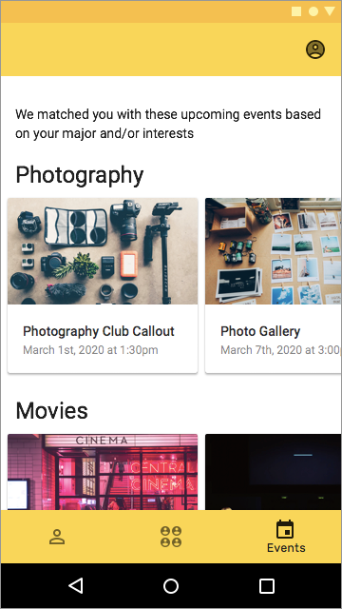
For “mentee” users, myMentor consists of three sections, that are presented in the bottom navigation:
Mentors
Student clubs
Upcoming events

Slide 32
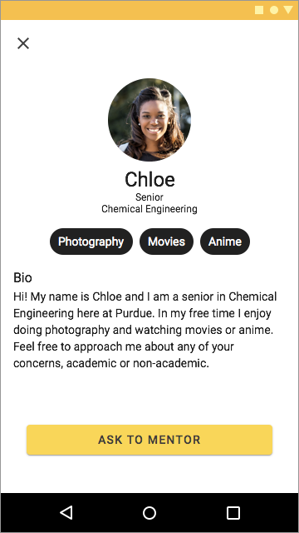
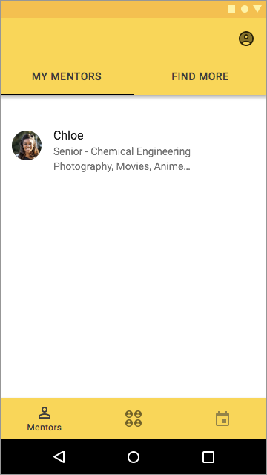
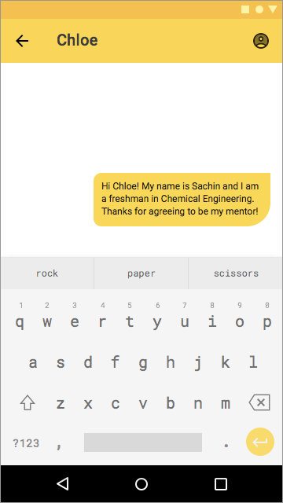
The mentors section displays all the matched mentors.
Students can read mentors’ information such as their major, year, interests, and a short bio.
Once approved by the mentor, the mentor and mentee can interact via private messaging, which solves the time committment concerns, as well as some of the anxiety issues of meeting in-person that new students might have.
Mentors

Slide 33
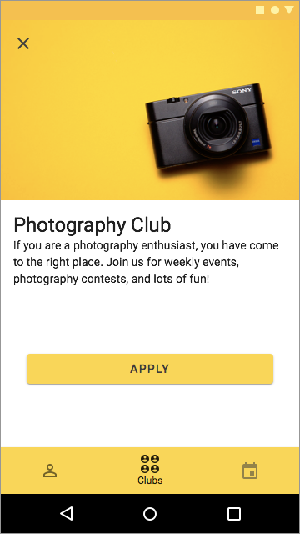
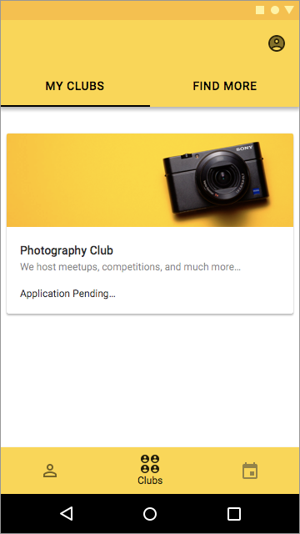
The student clubs section displays all the matched clubs that students can apply to join to.
Even though helping students find clubs was not in the design prompt, I decided to include this feature because it also allows students to connect more naturally.
Also, user research showed that most of the “mentors” interacted with their “mentees” through student clubs and organizations.
Mentors
Clubs

Slide 34
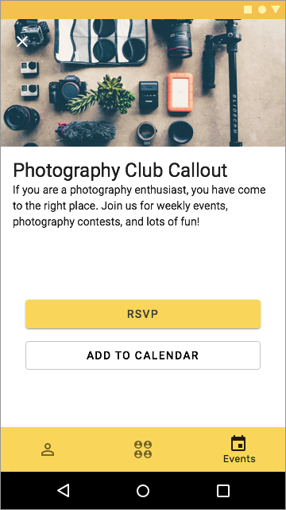
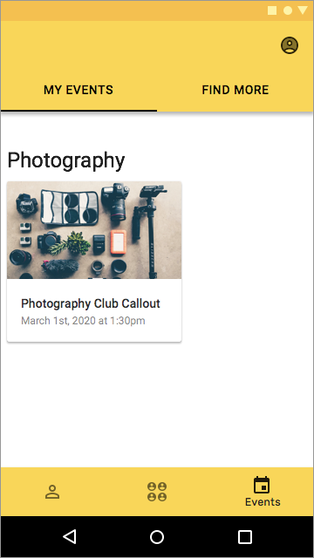
The upcoming events section displays all the matched events that students can RSVP or add to their calendar to not forget to attend.
Helping students find events similarly was not part of the design prompt, however I added it as a feature because it provides one more way of connecting naturally with other students.
Mentors
Clubs
Events

Slide 35
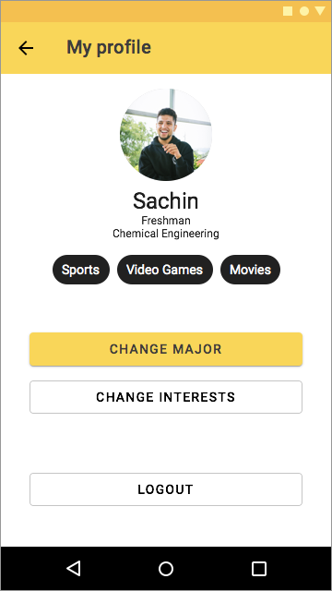
Finally, “mentees” can access their profile page by clicking the icon in the upper right corner in any page of the three sections.
In their profile page, students can change their major, interests, or logout from the application.

Slide 36

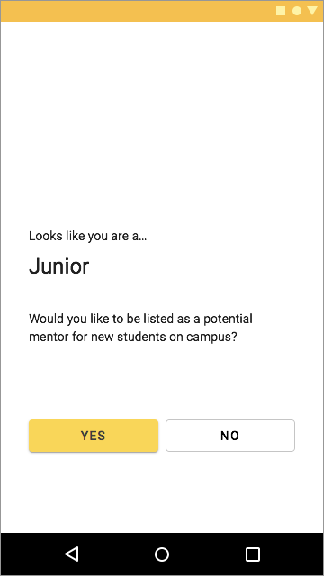
“Mentors” also login with their university account. The application also detects their major and asks them to confirm it.
The app automatically detects the year that the student is in and if the student is in their 3rd year or higher, it asks them if they want to be listed as a mentor.
Similar process applies to students who have been mentees before their 3rd year in college, where the app asks them if they want to be a mentor once they reach that stage.

Slide 37
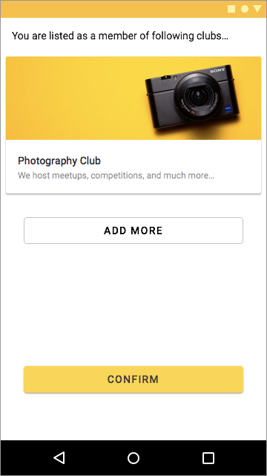
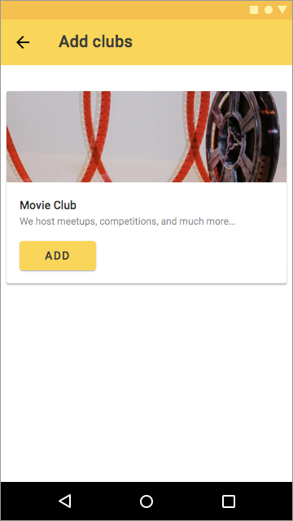
As more experienced students are more likely to be familiar with student clubs and belong to some already, the app does not match them with clubs.
For mentors, the app simply confirms the clubs that the student belongs to in order to use that information for matching with mentees.

Slide 38

Similar to mentees, mentors also choose their interests to help the app with matching.

Slide 39
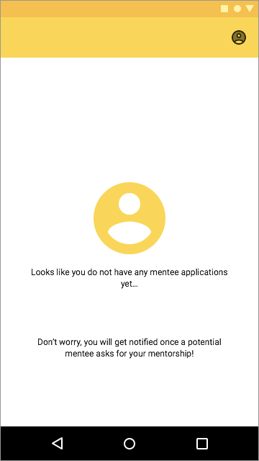
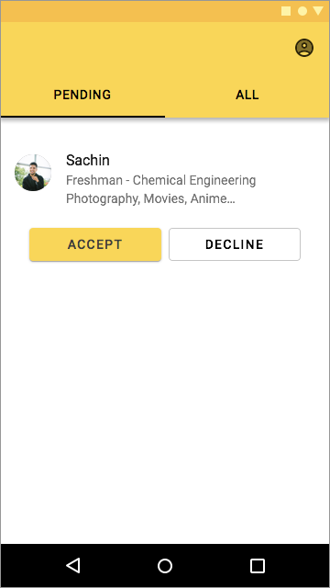
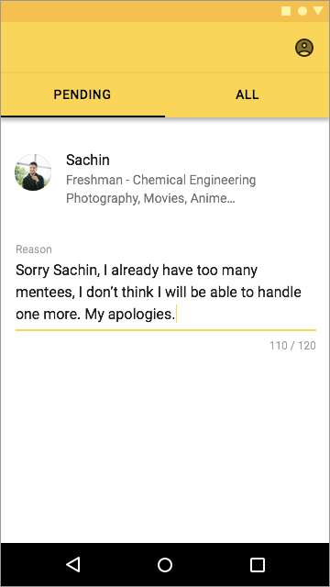
After the setup, the new mentor is automatically added to the mentor list. Once a mentee asks the student to mentor them, the app notifies the mentor.
The mentor can then approve or decline the application based on their availability.
If the mentor chooses to decline the application, they have to provide reasons for doing so.

Slide 40
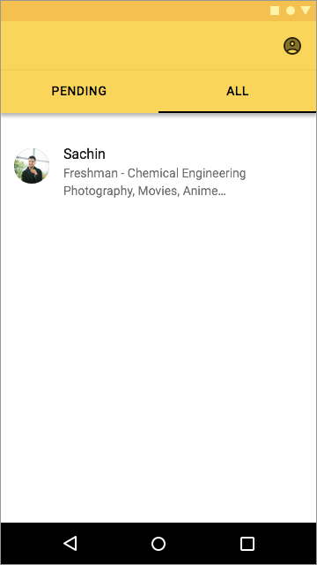
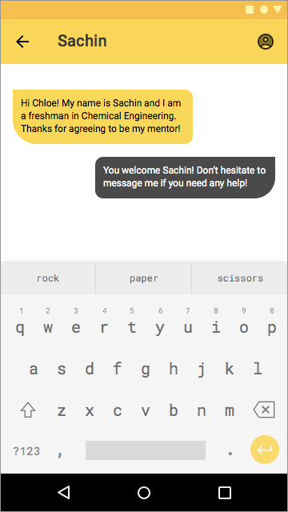
If approved, students can interact with each other through private messaging for their convenience.

Slide 41
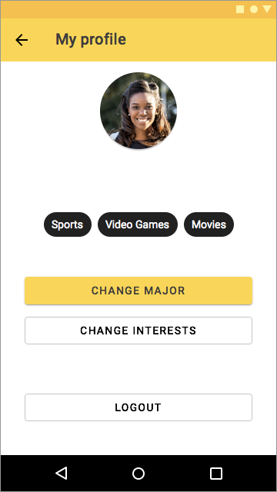
Similar to mentees, mentors can also access their profile page if they want to change their major, interests, or logout.

Slide 42
Prototype
Design
Sketches
User Flow
Wireframes
Final Design
Prototype
After the final design was done, it was time to run some quick evaluation testings to make sure the usability of the app was appropriate. Thus, I build a prototype using Principle for Mac.

Slide 43
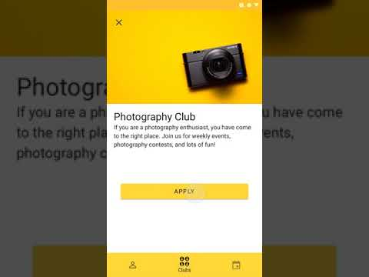
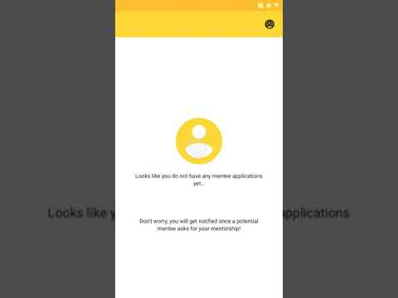
https://youtu.be/OcIYrm6FVCg
https://youtu.be/PjGH47Tg8aQ

Slide 44
Evaluation
Evaluation

Slide 45
With the prototype that I built, I ran some quick usability testing sessions with two users: one “mentee” and one “mentor”.
I gave them some task that an actual user will perform (e.g., apply to a photography club, decline a pending mentee application, and so on)
Both users were able to perform all the tasks and generally found the app to be relatively easy to use.
Evaluation

Slide 46
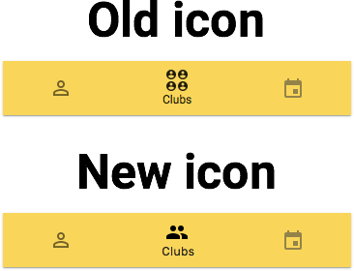
The only significant problem was that the “mentee” found the club section icon to be confusing. She suggested that the icon did not signal to her that this is a student club section. For that reason I went ahead and changed it.
Evaluation

Slide 47
The only significant problem was that the “mentee” found the club section icon to be confusing. She suggested that the icon did not signal to her that this is a student club section. For that reason I went ahead and changed it.
Evaluation

Slide 48
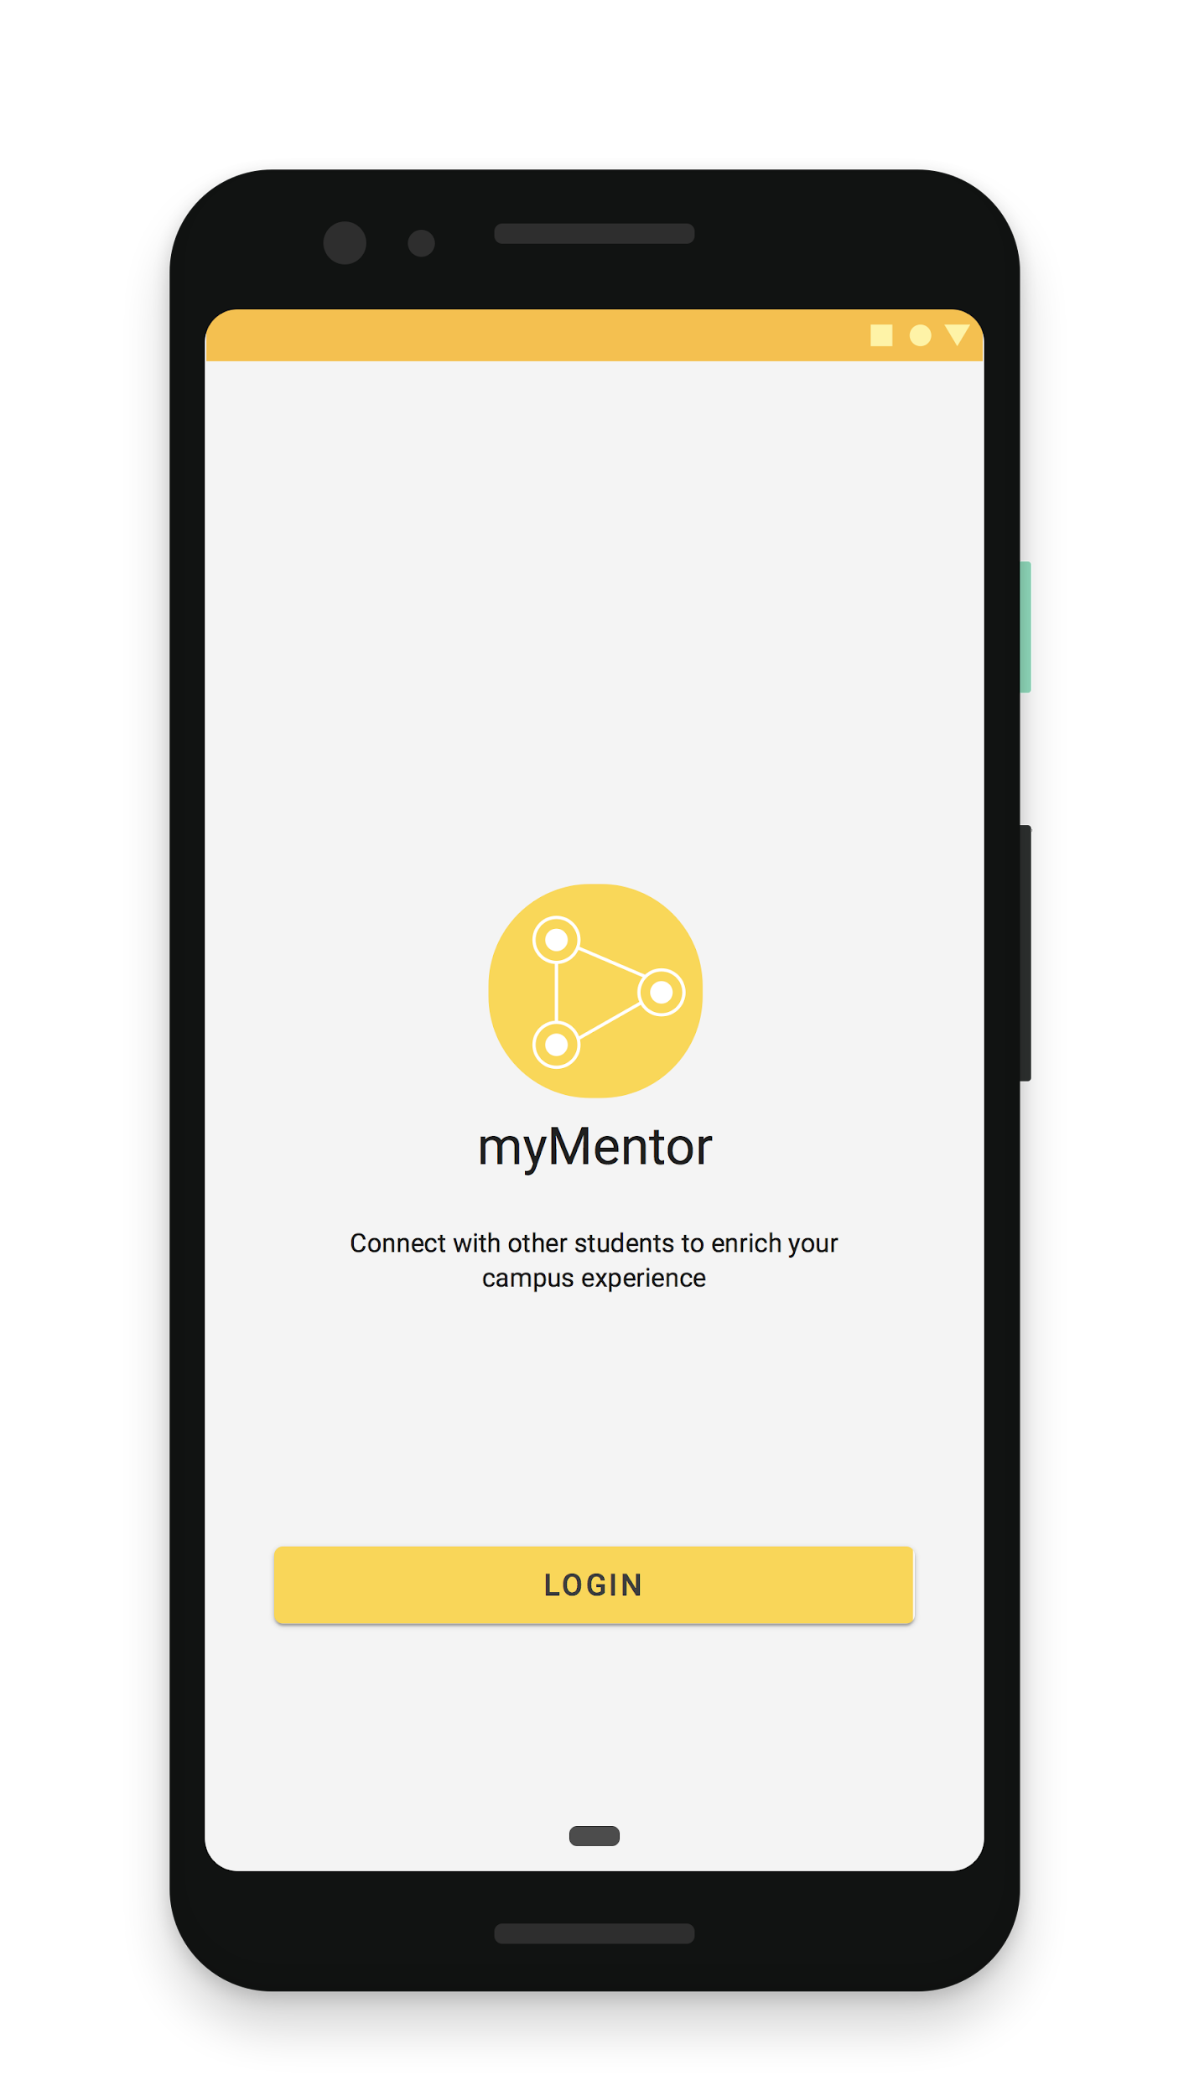
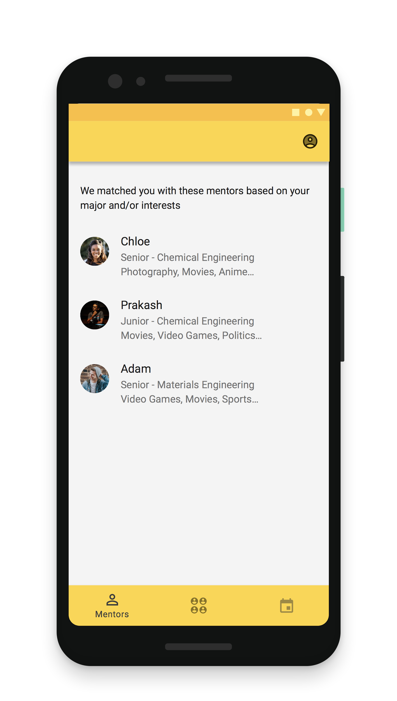
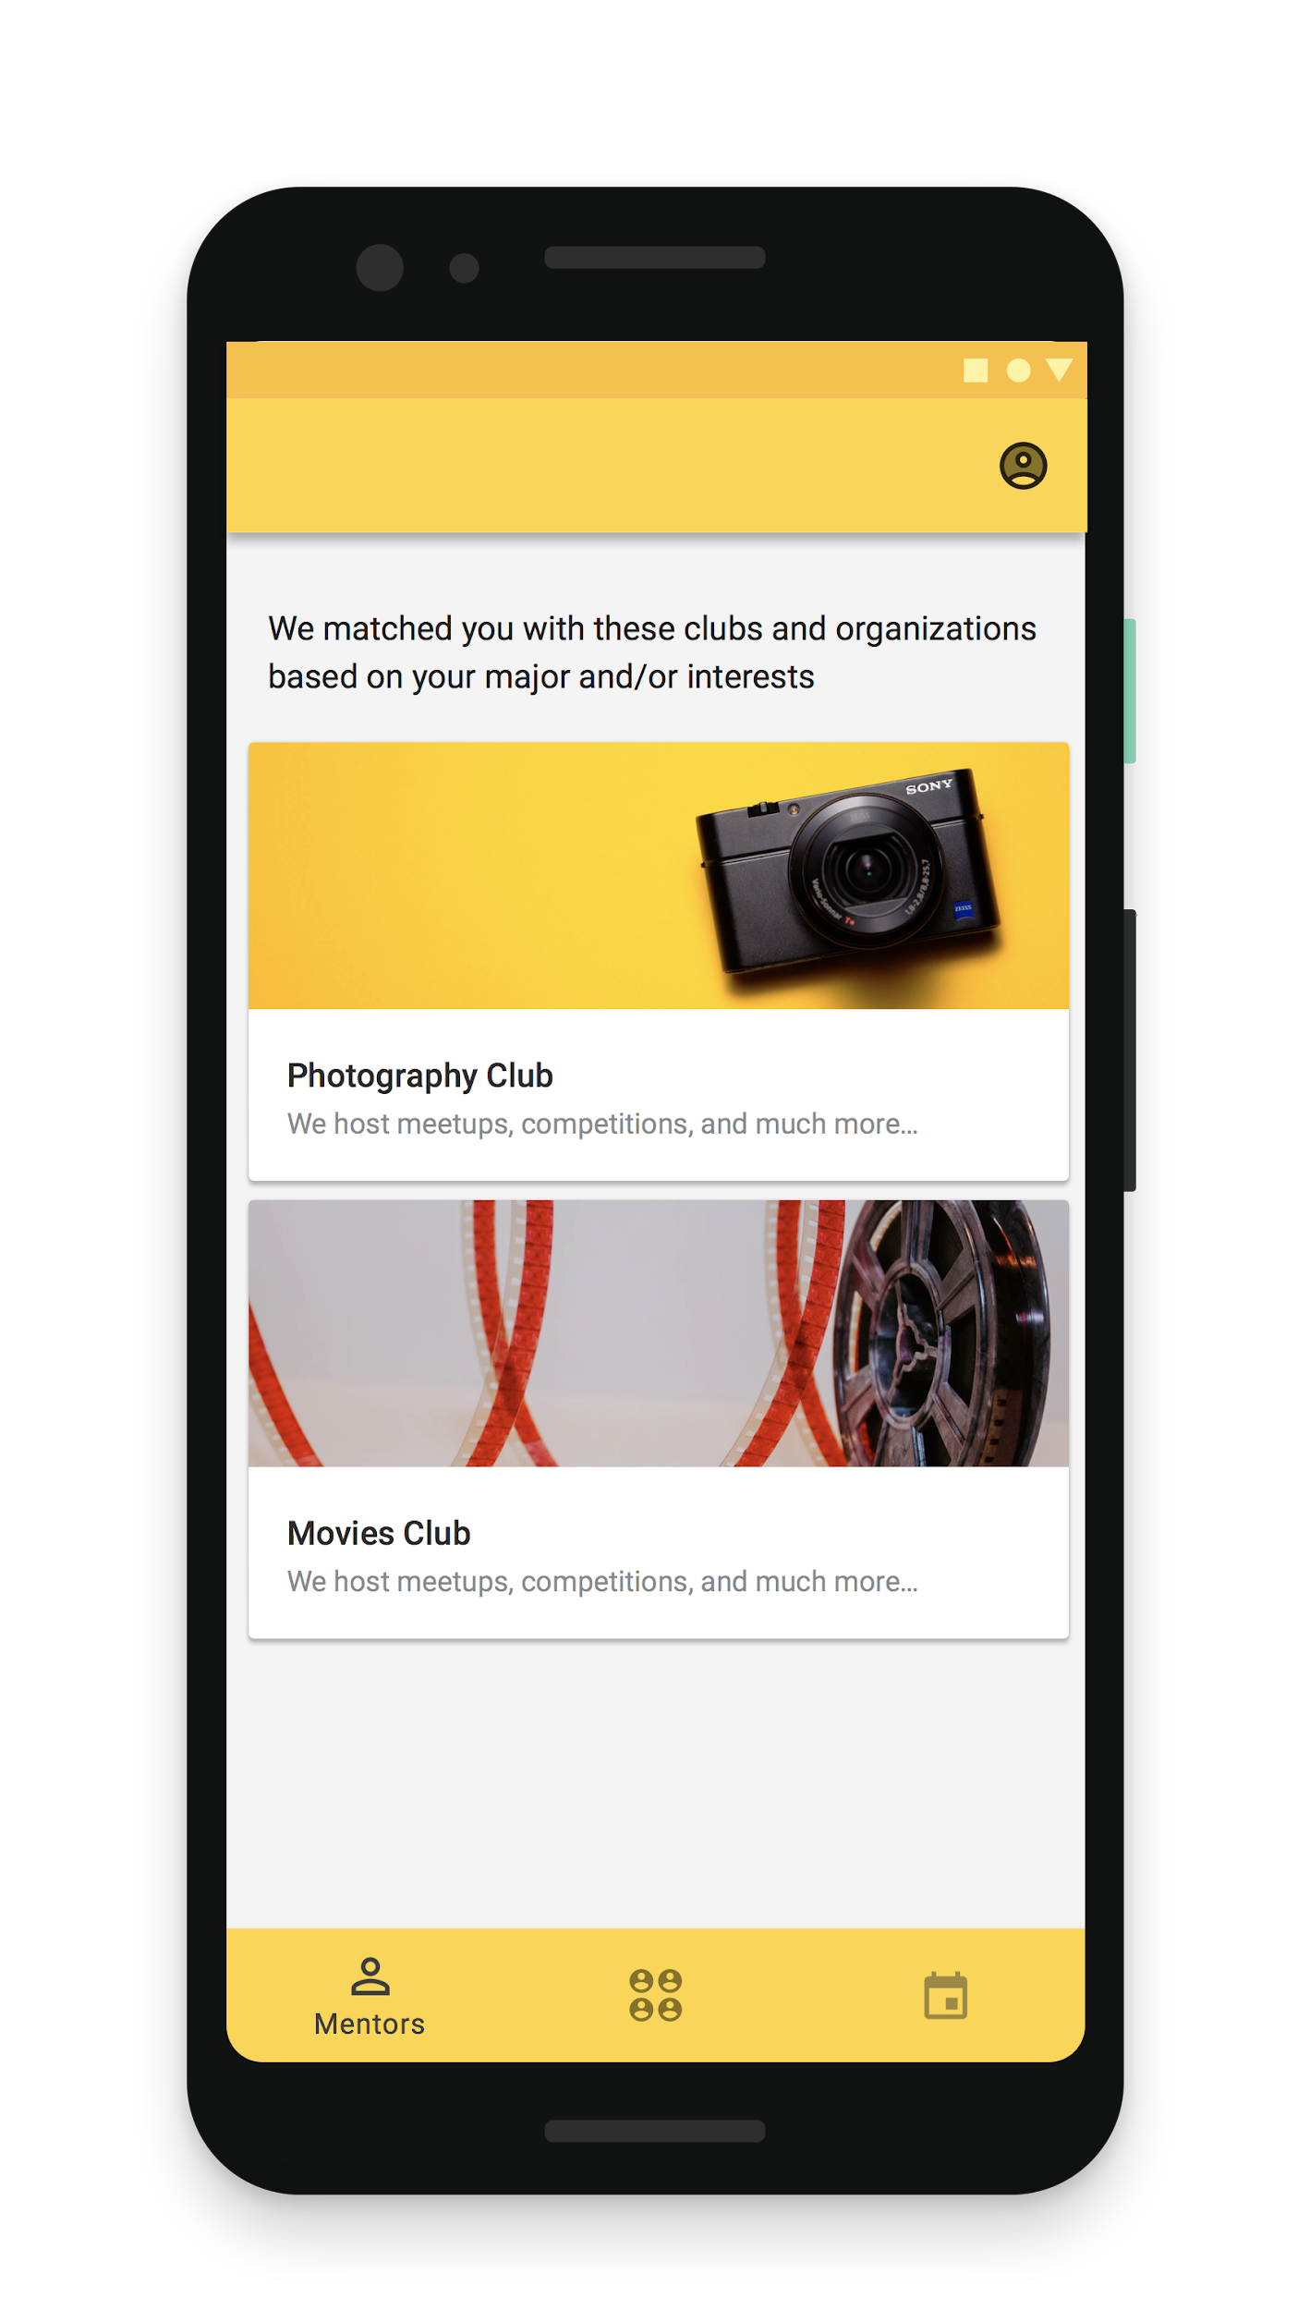
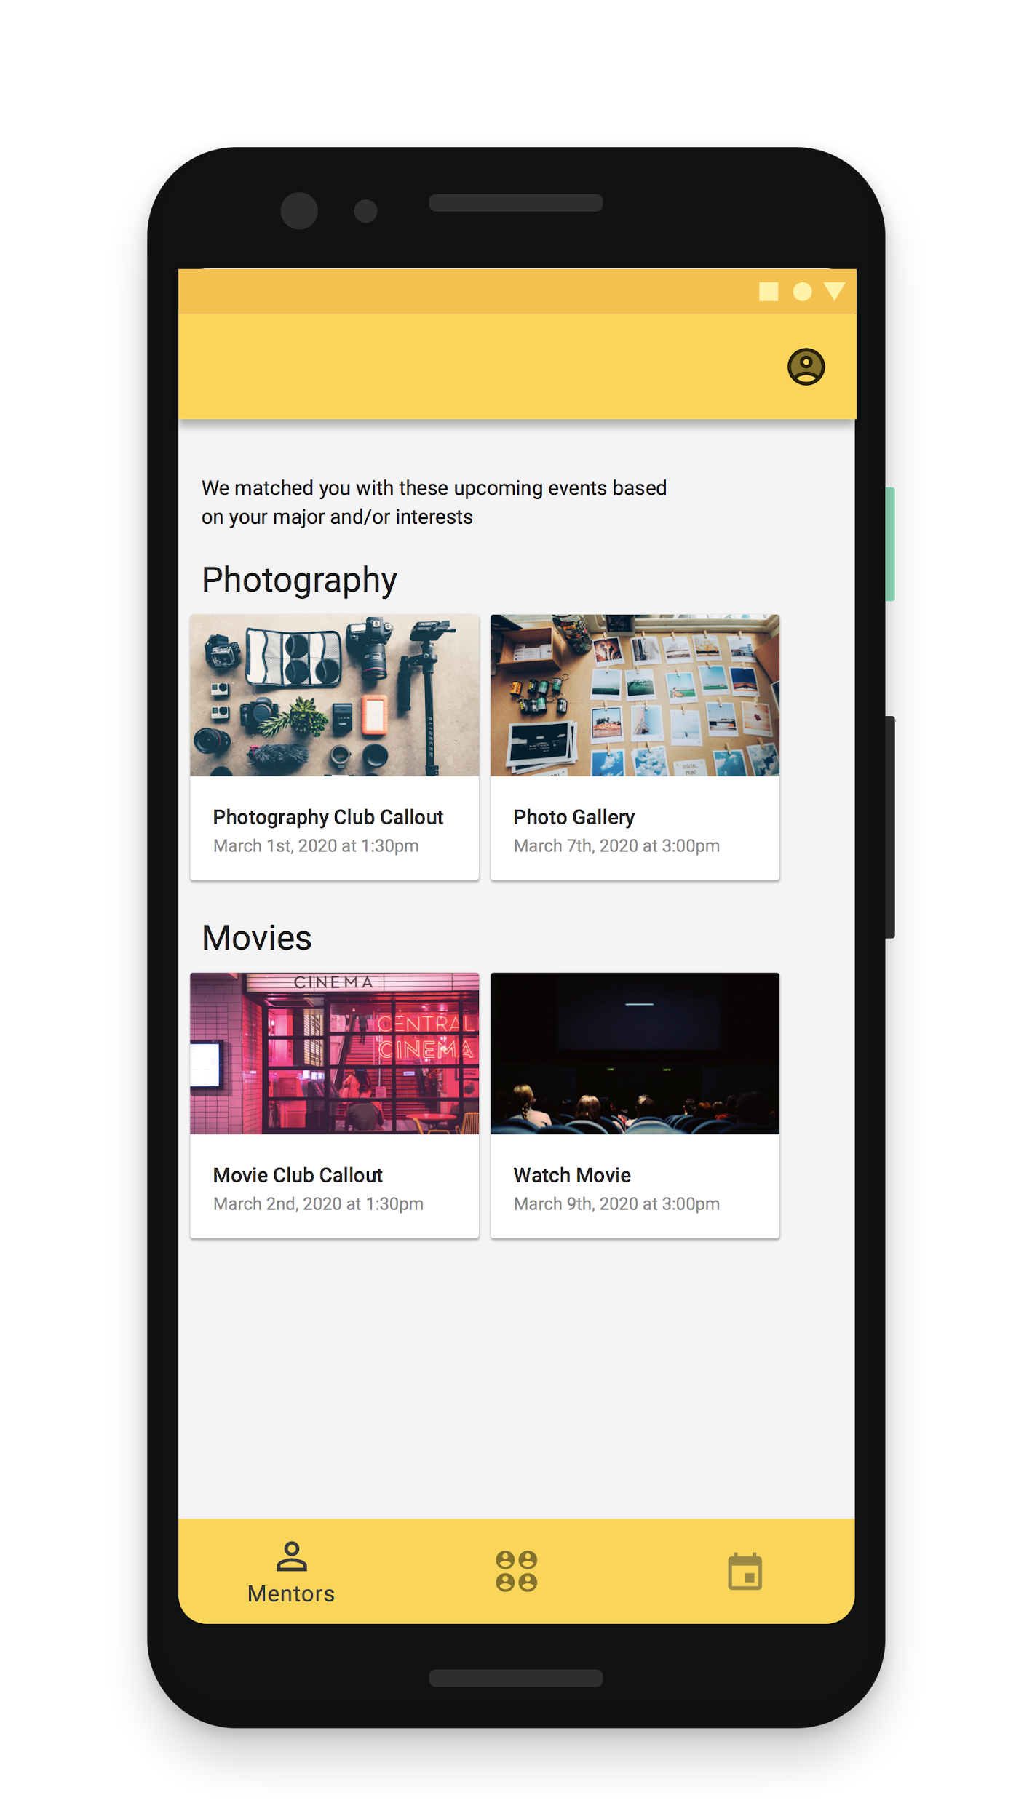

Slide 49
Thank you!

